Slide 1
Identifying and developing sporting talent: What do we know and why should we care?
Dr. Joe Baker
Lifespan Health and Performance Laboratory
York University

Slide 3
‘Talent’ is the most important concept in high performance sport today.

Slide 4
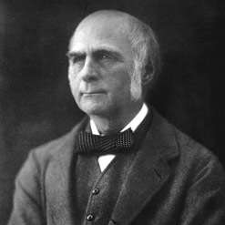
Francis Galton
A man must inherit good health, a love of mental work, a strong purpose and considerable ambition, in order to achieve successes of the high order of which we are speaking. The deficiency of any one of these qualities would certainly be injurious, and probably be fatal to his chance of obtaining great distinction.

Slide 6
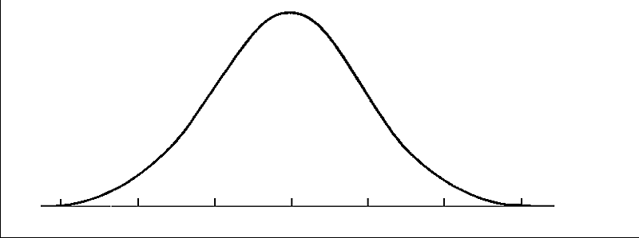

Slide 7
An innate quality (or qualities) that identified at one point in time can be used to predict success at a future point in time.

Slide 8
Talent Identification
The process of identifying athletes with this quality is termed talent identification.
Assumes:

Slide 9
Talent Identification
The process of identifying athletes with this quality is termed talent identification.
Assumes: talent is real

Slide 10
Talent Identification
The process of identifying athletes with this quality is termed talent identification.
Assumes: talent is real
and that it can be measured

Slide 11
The process of helping these athletes train, practice and succeed is termed talent development.
Talent development

Slide 12
5-8 million youth
High school - ~ 18,000 schools = 540,000 players
DIV 1 – 346 teams = ~4500 players
Why does this matter?
UK spent ~20 million pounds (~96 million shekels) for London Games
NBA draft – 2 rounds ~ 50 college players
15-20 go on to NBA

Slide 13
Interesting Factors that Seem to Predict Sporting Talent
1. Birthdate

Slide 14
Birthdate?
Horoscopes (Zodiac) – comes from Hellenistic and Babylonian astronomy, widely used in ancient Greek and Roman cultures.
Very early system of star mapping, dividing the night sky into 12 equal sections of celestial longitude.
Notes:
Zodiac is of Greek/Latin origin meaning ‘circle of animals’

Slide 15
How your birthdate affects your development
1. Season of birth effects
Asymmetrical distribution of people with the same characteristic born during the same season of the year
Winter/Spring births demonstrate heavier birth weight, longer total length and longer limb length (McGrath et al., 2005). Also related to adult overweight/obesity (Wattie, Ardern & Baker, 2007)
Abnormal psychology (Schizophrenia, Bipolar disorder among others) 100+ studies

Slide 16
How your birthdate affects your development
Relative age effects
Resulting from age grouping policies

Slide 17
Relative Age Effect in NHL draftees 2000-2005

Slide 18
RAE has been found in a range of sports – soccer, ice and field hockey, cricket, baseball, handball…
Possible explanations
‘Older’ athletes experience more success.
‘Older’ athletes more likely to be seen as gifted.

Slide 19
Interesting Factors that Seem to Predict Sporting Talent
Birthdate
Handedness

Slide 20
Handedness
Between 9-12% of population is left-handed
Proportion in many sports is much higher
Tennis
Handball
Volleyball
Left orientations in ice-hockey, combat sports (fencing, judo, MMA)

Slide 21
Handedness
Why?
Two hypotheses:
Neuroanatomical advantage
Frequency dependent advantage
Can be reversed!
(Schorer, Loffing, Hagemann & Baker, 2012)

Slide 22
Interesting Factors that Seem to Predict Sporting Talent
Birthdate
Handedness
Genes

Slide 23
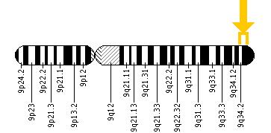
Chromosome 9
COL5A1 Gene
Produces Collagen, Type 5, Alpha 1 protein
Affects likelihood of tendon injury.
Has potential to affect the amount and type of training a person can do.

Slide 24
Interesting Factors that Seem to Predict Sporting Talent
Birthdate
Handedness
Genes
Personality

Slide 25
Personality
Elite Athletes vs. Non-Athletes and Low Levels of Competition
Extraversion
Agreeableness
Openness
Neuroticism
Conscientiousness

Slide 26
Personality
Self-regulation: More skilled performers are better able to regulate their own learning

Slide 27
Personality
Self-regulation: More skilled performers are better able to regulate their own learning
Increased “planning” and “reflection” was associated with greater training volume (Elferink- Gemser et al., 2015)
“Self-monitoring” was positively related to time spent in deliberate practice (Bartulovic, McCardle, Baker & Young, under review).

Slide 28
Interesting Factors that Seem to Predict Sporting Talent
Birthdate
Handedness
Genes
Personality
Birth City Size
But, do they really predict ‘talent’?
Limitation of work in this area = Retrospective designs

Slide 29
Systematic Review
Robinson, Wattie, Schorer & Baker, under review
Search terms “talent”, “expertise”, “giftedness”, AND “sport”
Web of Science, Sport Discus
Timeframe 1990-2015
1696 articles

Slide 30
Systematic Review
Robinson, Wattie, Schorer & Baker, under review
20 studies
Prospective (1 year) with skill-based comparisons
Recent (all published since 2004)
65% males only
Mostly soccer (n=7) followed by rugby league (n=3), gymnastics (n=3)
Largely from Europe (n=16)
Mostly physical variables (n=12) with only 4 considering a mix of variables

Slide 31
Prospective Studies of Talent ID
Koz, Fraser-Thomas & Baker (2011)
Scan. J of Sci Med Sport
Considered accuracy of professional sports drafts (NHL, NFL, NBA and MLB) in predicting future performance
Results = very poor accuracy (ranging from 3% to 17% variance accounted for in MLB and NBA respectively)

Slide 32
Prospective Studies of Talent ID
Schorer, Rienhoff, Fischer & Baker (under review)
Considered accuracy of coaching talent selections by tracking where selected and rejected players end up.
N = 58 German handball players measured in 2001 at age 13-14
Assessed by national and regional coaches
10 yrs later - 14 were National team members

Slide 33
Prospective Studies of Talent ID
Schorer, Rienhoff, Fischer & Baker (under review)
A priori probability = 76% (everyone forecasted as untalented)
Accuracy ranged from 79% for National level coaches to 75% for regional level coaches
Similar rates of Type I and Type II errors
Interestingly, randomly chosen novices had an accuracy rate of 73%.
More likely to make Type II errors

Slide 34
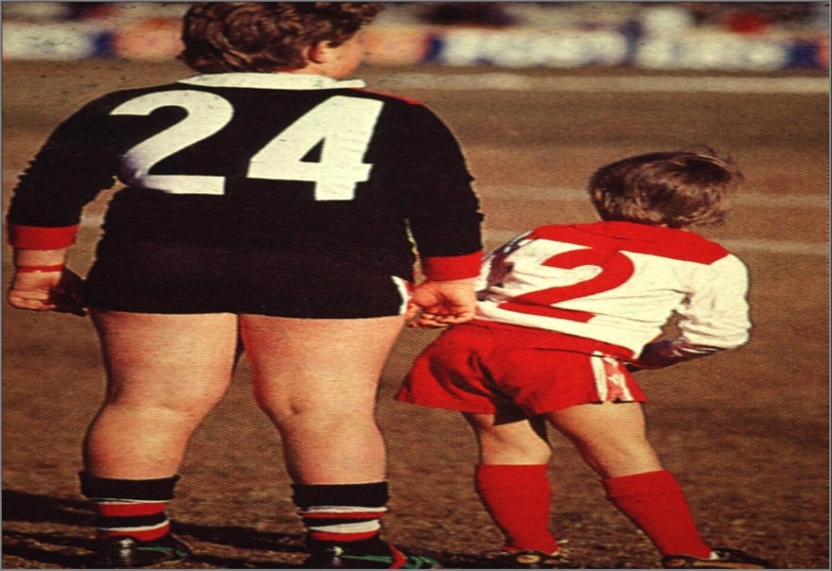

Slide 35
ACCURACY
TIME

Slide 36
Beliefs about talent matter!
How do you explain/attribute your capabilities?
Beliefs about talent and its development affect motivation, learning and performance
Fixed/Implicit = natural ability, nature over nurture,
Growth/Acquirable = hard work, nurture over nature

Slide 37
Beliefs about talent matter!
How do you explain/attribute your capabilities?
Beliefs about talent and its development affect motivation, learning and performance
Fixed/Inherent mindsets are associated with:
Decreased motivation, less practice, learned helplessness

Slide 38
‘Talent’ is the most important concept in high performance sport today.
Systems are still designed with this concept as the foundation
Funding is based on the assumption that talent is real and coaches can/should identify it
This approach has high costs re: early de-selection and dropout

Slide 39
Key Messages
Forget about talent
If it exists, we don’t know how to measure it.
Your messages about talent may be harmful
Foster a growth mindset but be realistic
Focus on quality of training/practice
This is where your greatest impact will be

Slide 40
Thank You!
Questions?
FOR MORE INFO:
Email: bakerj@yorku.ca
Web: www.yorku.ca/bakerj
Twitter: bakerjyorku

